Slide 1

Introducing Kanban
Balancing Work In Process And Capacity

Slide 2

Notes:
More work than time
leads to rush jobs and people just trying to push the work off to someone else

Slide 3

Notes:
Old-school waterfall or phase-gate approach
Massive batch size of work
Excessive design up front
Carefully controlled handoffs of work, “tossing them over the fence”

Slide 4

Notes:
Large batches of work build up over time and across each phase
Each hand off adds more work for that team to handle, making it more likely that previous knowledge is lost
If even a small item was incorrect in the beginning stages, the covariance effect can be massive, causing 10 to 100 times the cost to fix in later phases

Slide 5
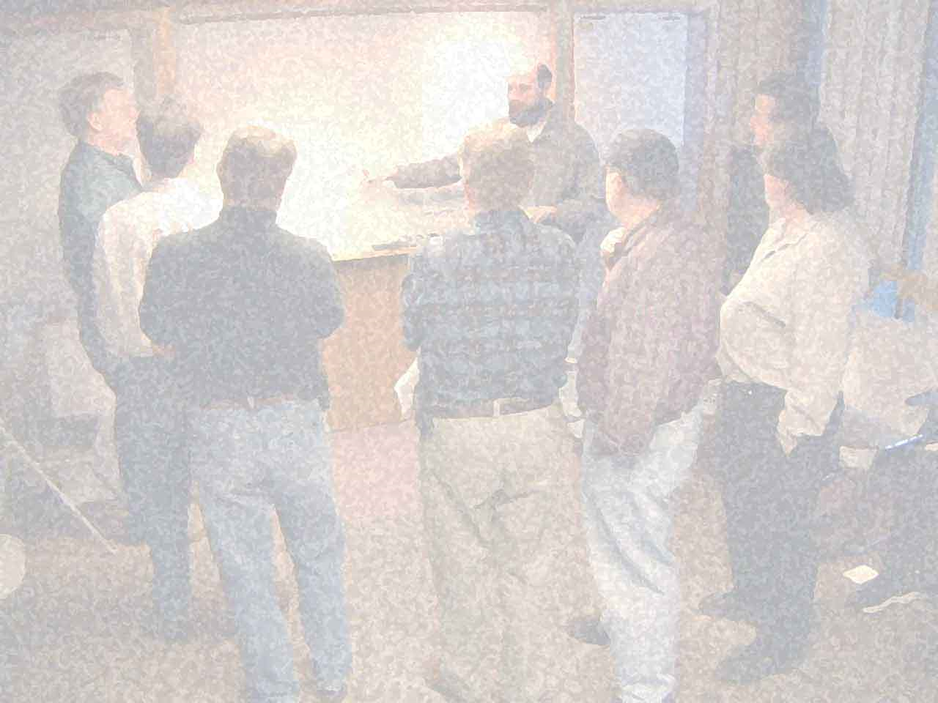
We are uncovering better ways of developing software by doing it and helping others do it.
Notes:
Agile Manifesto got it right
“light-weight” processes, focused on rapid feedback and delivering small, valuable units of work in
Focus on working software and human relationships, etc, rather than excessive documentation and formal process, etc
Does not obviate the need for documentation and process – rather puts them into the correct light of ‘do they add value’

Slide 6

Notes:
Some agile manifestations got a few things a little bit off
Iterative != timebox
not everything fits into a 2 week iteration or 1 month sprint
Rhythm and cadence can be complex when dealing with multiple aspects of the process

Slide 7

Notes:
The customer’s needs will change without regard to time boxes
With even a small change, schedules are thrown out the window and we scramble to catch up and re-plan
Short iterations or sprint help to alleviate this, but can create additional problems in delivering valuable units of work
We (industry) seem to be stuck in reactionary mode instead of proactive approach

Slide 8

Lean Thinking
Notes:
Suppliment agile manifesto and methodologies with Lean Thinking and Lean principles
Eliminate waste
Respect for people
Continuous improvement
Systems thinking

Slide 9
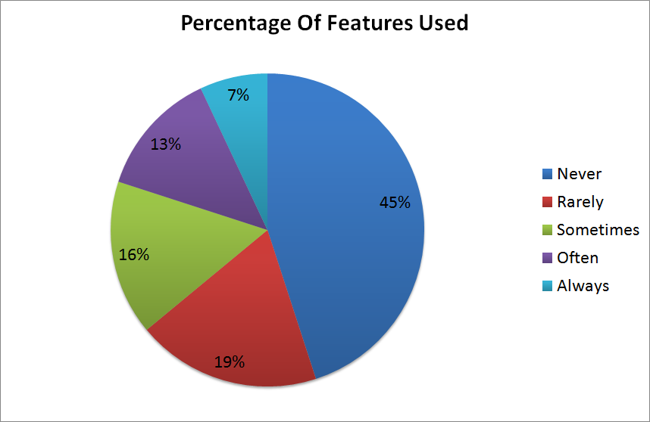
Source: Standish Group CHAOS Study
Notes:
Standish Group’s CHAOS report reveals dramatic data about used features
Single largest waste of time and effort in software development: working on features and functionality that are never used
Take time from Never and Rarely features (58% of features) and convert that into cost savings and/or additional functionality that the customer needs

Slide 10

Notes:
Scrum and XP tend to focus on the development team: protecting them from management and limiting customer input around time boxes
Lean thinking focuses on the whole value stream: inclusive of management and customer based tasks and processes
Focus on the flow of value through entire process, not just development effort – from concept to cash

Slide 11

Notes:
Defect prevention: increasing the quality of the products and services
Rather than quality inspection: searching for bugs in the system after the system has been created – reverse engineering the functionality, to test it
Reduce lead time: deliver working, stable, valuable software to the customer more often
Deliver exactly what’s needed, exactly when it’s needed, to exactly who needs it

Slide 12

Lean Tools
Notes:
Drawn from many other process improvement programs and sources: TQM, Six Sigma, ToC, Real Options, etc

Slide 13

start
finish
Notes:
Value stream mapping
Show all of the steps and queues that it takes to get from input to delivered value
Focus on value-add vs. non-value add time
Typically more effective to focus waste elimination on the non-value added time

Slide 14

Notes:
Andon – stop the line when an error is found
Jidoka – autonomation. Automation with a human touch. Stop and fix it now. CI and broken builds. Big flashing lights, etc

Slide 15

Notes:
Root cause analysis: 5 why’s. Not who, but why. Fix the system structure and organization issues that facilitated the problem
Can’t be afraid to get your hands dirty. Must go to Gemba – the place where the action is occuring – to see for yourself: Genchi Genbutsu
Poka-Yoke - Mistake proofing: put in measures to prevent the problem in the future

Slide 16

Notes:
PDCA: plan do check act
Process improvement
Kaizen: Continuous improvement
Like peeling an onion that never ends

Slide 17

Notes:
Production leveling
Large batches of work hide systemic problems by letting us push work on to next step, even if they are not ready for it. Let’s people jump between tasks while waiting for issues to be solved
Large work items hide localized problems at individual step by letting people jump around between parts of the large item, while waiting for issues to be solved
Large sizes for batches and work items create quality problems, reduce feedback and increase lead time; reduces flow of value, increases cost, and delays delivery to customer
Reducing batch sizes and variance in work item sizes, to increase flow of value, feedback, stabilize cycle time, etc

Slide 18

Pull Systems: Kanban
Notes:
Pull systems – authorizing work based on capacity, not schedule

Slide 19

Notes:
Origin of pull systems: grocery store shelves
Customer pulls value, causes work all the way back up the value stream

Slide 20

Notes:
Working to schedule in non-predictable, non-linear system will cause delays
“failed” iterations / sprints caused by delay and overbooking work

Slide 21

Notes:
Recognize the capacity of the system and the individual resources
Authorizing work by available capacity, not schedule
Balancing capacity and demand

Slide 22

Notes:
Queues: protecting against bottleneck and starvation
Facilitating hand off between resources / steps in process
Managed inventory
Step + Queue = WIP Limit

Slide 23

Notes:
Kanban: signal to do work

Slide 24

Notes:
Rhythm & flow. Synchronizing the various aspects of a software development system and teams
Time boxed iterations/sprints couple various synchronization points, artificially
Decouple the rhythms of: planning work, start and stop of work, demoing value, delivering value, retrospectives and improving, etc
Focus on the customer’s scheduling needs for customer related activities: demos, planning, prioritization, etc
Focus on the internal team’s scheduling needs for internal team needs: retrospectives, work breakdown, start and stop of work, etc

Slide 25

Getting Started
Notes:
How to get started with Kanban in software development. 4 basic steps:
1 – visualize your process
2 – limit work in process
3 – pull, don’t push
4 – monitor and improve. This is where the real benefit of lean / kanban is found

Slide 26
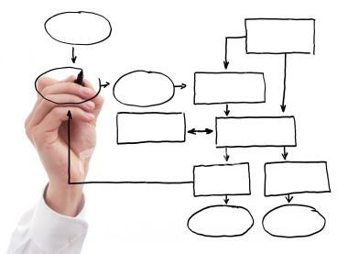
Notes:
Visualize your process – your value stream
It’s your process, kanban won’t force any given steps on you
Kanban is process control, not how-to process work to add value

Slide 27

Notes:
Limit work in process
Recognize the inherent capacity of the system and the team, to get things done
Set work in process limits for the various steps in the system
Identify queues – handoffs between resources and steps

Slide 28

Notes:
Pull, don’t push
Read the kanban board from right to left
Pull work into process when capacity is available (when Kanban signal is received)
(run kanban simulation here)

Slide 29

Monitor & Improve
Notes:
Monitor and improve: Kanban as a change management system
The real value in a kanban system is using the generated metrics as indicators of need to change

Slide 30

Notes:
The mechanics of kanban are necessary but not sufficient
Focusing on the kanban signal itself, or the simple mechanics of pull and limited WIP will miss out on a lot of opportunity for improvement
Kanban is a thinking system – there is no prescriptive way to implement it. You must think for your team and circumstances

Slide 31

Notes:
Cycle Time: the time it takes to get work item through a process. Macro and Micro view of cycle time
Lead Time: time it takes from request for feature or functionality, to delivery of feature or functionality
Production Rate: how often a task is completed
Process Cycle Efficiency: Cycle Time (System Level) / Lead Time
These are trailing indicators

Slide 32

Notes:
Focus on lead time, not production rate
Reducing lead time leads to capability to increase production rate
Can reduce lead time by increasing speed of cars – no additional infrastructure needed, just need people to drive faster
Focusing on production rate will not reduce lead time, may cost more – have to build more capacity – more lanes on the highway

Slide 33
Step 1
Step 2
Step 3
Step 4
3
2
5
3
Input
Output
Done
Done
Done
Notes:
Total WIP in system and current WIP in each step are leading indicators
Remember: Step + Queue = WIP limit
Identify the problems that are already occurring in this system

Slide 34
Feature Request
User Story / MMF / Use Case
Work Items (Tasks)
Notes:
Production leveling in software engineering: breakdown and rollup of work
Iterative and incremental
Facilitates rapid feedback at work item level
Measure and monitor at all levels of breakdown / roll up – multi-tiered kanban boards

Slide 35

Notes:
Push is not inherently evil
Every pull system needs a little push
Customer pushes requirements onto us
Scheduling work breakdown and work item design: pushing work items into backlog, ready to go

Slide 36

Notes:
Before you get started: kanban is not “the one true way”. There are no silver bullets
If you are not willing to do the work, to think through your specific circumstances, then kanban and lean systems may not be right for you
If your team is already highly successful, and like what they are currently doing, this may not be for you
If your organization is top-down, command-and-control style, you will likely have a large fight on your hands
At a minimum, though, most teams should be able to implement limited WIP and pull, within their own spheres of influence
If you’re looking to take your process to the next step and are willing to pay the price of facilitating systemic change in your organization, kanban is an effective facilitator of change, when applied to your specific circumstances

Slide 37

Notes:
Time for Q&A

Slide 38
Additional Resources
Limited WIP Society: resources for kanban & pull systems http://www.limitedwipsociety.org
KanbanDev: user group / mailing list http://finance.groups.yahoo.com/group/kanbandev/
David Anderson: Kanban in software development industry leader http://agilemanagement.net
Tom & Mary Poppendieck: lean software development experts http://www.poppendieck.com/
Scott Bellware: lean software development expert http://blog.scottbellware.com

Slide 39
About Me
Contact Me: Twitter: @derickbailey Email: derick@derickbailey.com
Blogging With LosTechies: http://derickbailey.lostechies.com
Current Employer: McLane Advanced Technologies http://mclaneat.com
About Me: Sr. Architect, Software Engineer, Lean / Agile Coach 12+ years professional software development experience 20+ years writing code

